Slide 1
Definitions
Sample from target distribution (probability distribution)
Sample from Markov chain

Slide 3
Understand theory
Implement code on known issue
Implement code on new problem

Slide 4
MCMC Methods for sampling

Slide 5
Problem
When you don’t have access to direct sampling methods, you can use MCMC to generate a series of samples based on the probability distirubtion

Slide 6
Monte Carlo Simulations
Estimate the possible outcomes of an event

Slide 7
MCMC
Relies on iterative sampling (similar to terminal flow in gflownet)
New state config obtained at each step of the chain by making small stochastic change to config of prevopus step
Samples are sampled from correct distribution but sometimes there are sets of distributions unlikely to provide enough diversity in distribution modes (mode mixing problem)
Can be alleviated by sampling longer modes

Slide 8
Markov chains
A Markov chain: a random sequence of states in some state space in which the probability of picking a certain state next depends only on the current state in a chain and not history (memory-less)
MCMC
Samples from a distribution
Constructs and simulates a Markov chain whose stationary distribution is p(x)
After an initial “burn-in” phase, the states of the Markov chain are distributed according to p(x)
In discrete cases: the key quantiy for characterizing a Markov chain: transition operator: T(xi+1|xi)

Slide 9
ML Algorithm
Discrete (transition matrix), continuous (transition kernel)

Slide 10
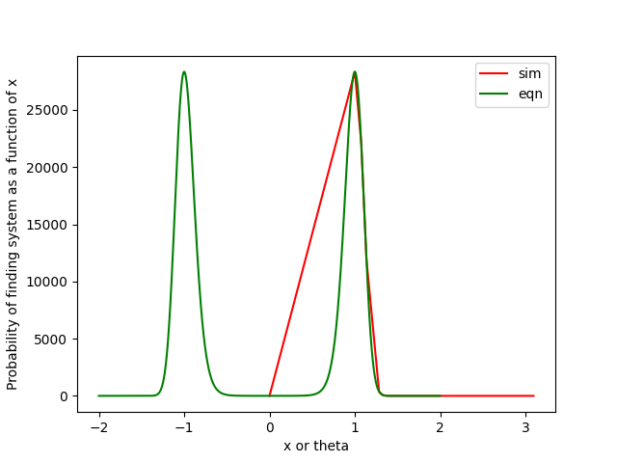
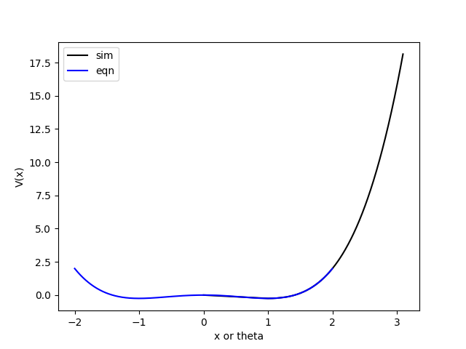
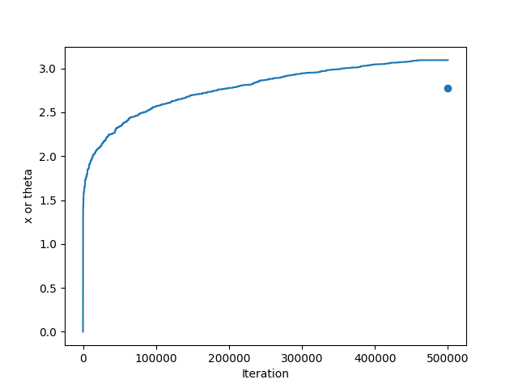
Results, t=283 K

Slide 11
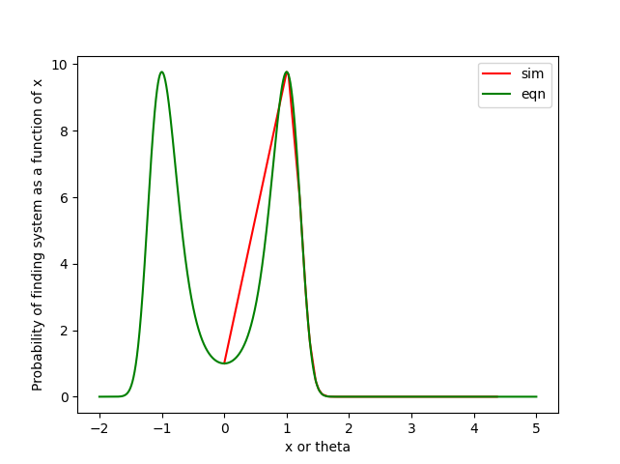
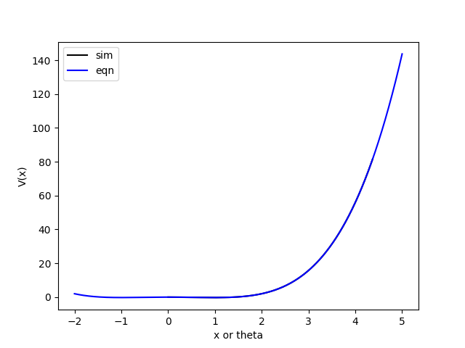
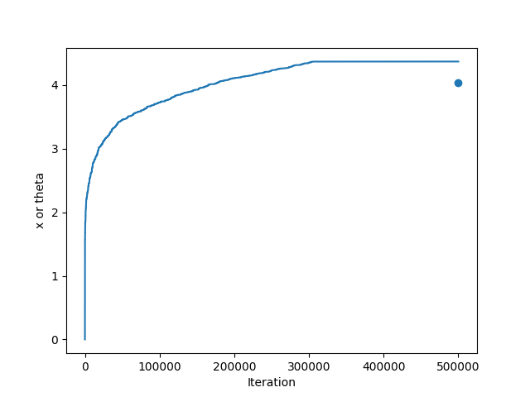
Results, t=1273 K

